Slide 1
CHAPTER 3
DERIVATIVES

Slide 2
CONTENTS
3.1. Derivatives
3.2. Derivative as a Function
3.3. Differentiation Formulae
3.4. Rates of Change in the Natural and Social Sciences
3.5. Derivatives of Trigonometric Functions
3.6. The Chain Rule
3.7. Implicit Differentiation
3.8. Derivatives of Logarithmic Functions
3.9. Related Rates
3.10. Linear Approximations and Differentials

Slide 3
3.2. THE DERIVATIVE AS A FUNCTION
3.2.1. The Derivative as a Function
3.2.2. Differentiable Functions
3.2.3. Non- Differentiable Functions
3.2.4. The Second Derivative

Slide 4
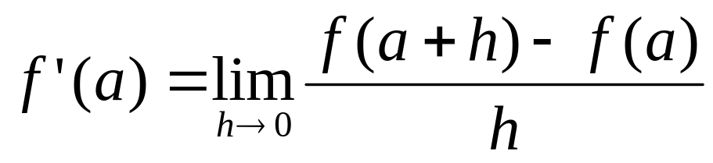
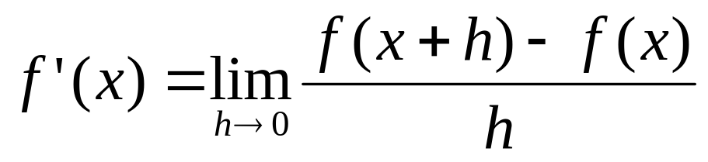
3.2.1 The Derivative as a Function
Recall that the derivative of a function y=f(x) at a fixed number a is defined by
If we replace a by the variable x, then we obtain

Slide 5
Given any number x for which this limit exists, we assign to x the number f’(x). So we get a new function f’ called the derivative of f
Domain (f’) = {x ∈ Domain (f) / f’(x) exists}

Slide 6
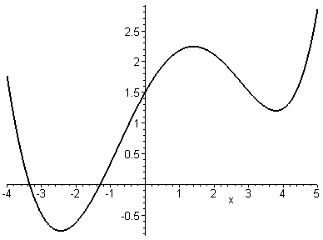
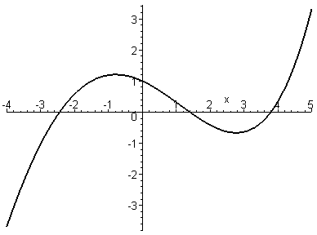
Example. Use the graph of the function f to graph f ‘
B
C
y=f(x)
Solution. At A, B, C the tangents are horizontal so the corresponding points on the graph of f ‘ lie on the x-axis.
A
y=f’(x)
A’
B’
C’

Slide 7
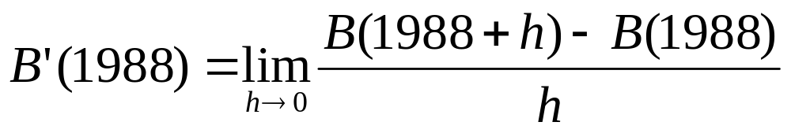
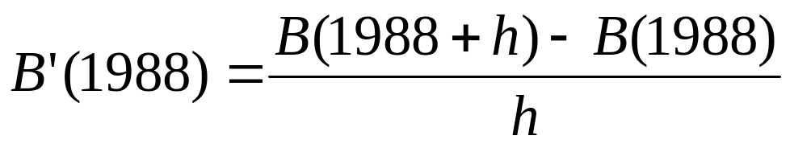
Example. The population B(t) of Belgium is given by the following table. Construct a table of values for B’
Solution. Let’s start by approximating B’(1988), the rates of change in 1988
t | B(t)
1980 | 9.847
1982 | 9,856
1984 | 9,855
1986 | 9,862
1988 | 9,884
1990 | 9,962
1992 | 10,036
1994 | 10,109
1996 | 10,152
1998 | 10,175
2000 | 10,186
We can take h small and approximate B’(1988) by

Slide 8
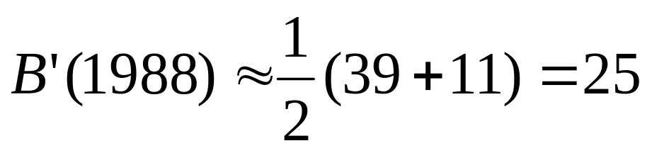
The graphs of B and B’ are sketched in next slide with corresponding best fit curves
t | B’(t)
1980 | 4.5
1982 | 2.0
1984 | 1.5
1986 | 7.3
1988 | 25.0
1990 | 38.0
1992 | 36.8
1994 | 29.0
1996 | 16.5
1998 | 8.5
2000 | 5.5
e.g with h =2 we have B’(1988) ≈ 39 with h =-2 we have B’(1988) ≈ 11 So we can approximate B’(1988) by
The other values of B’(t) are computed in the following table

Slide 9
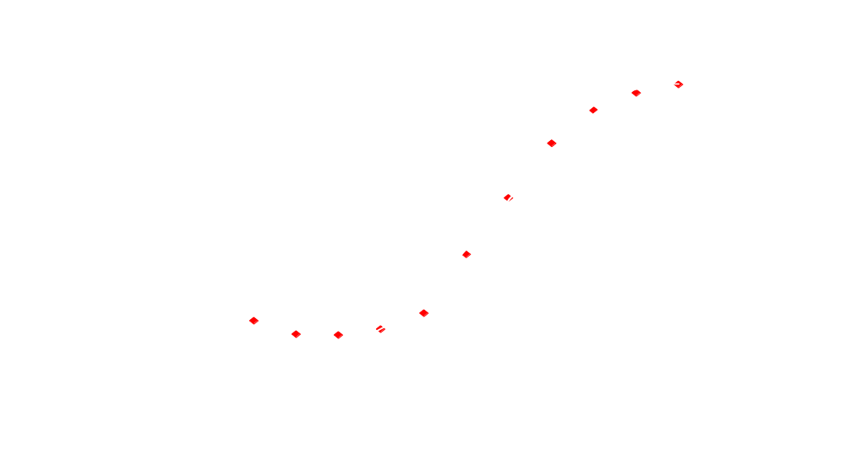
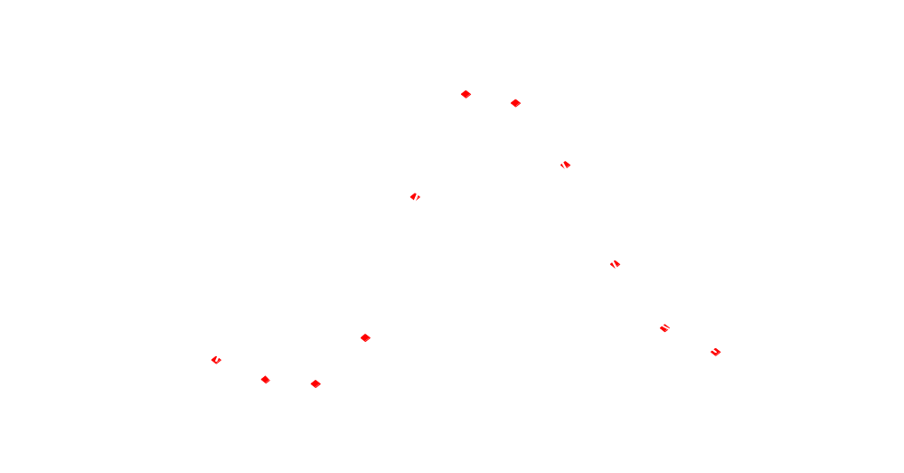

Slide 10
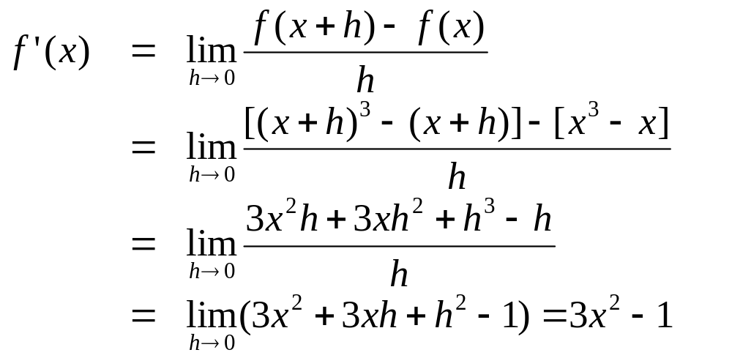
Example. (a) find f’ for f(x)=x³-x
(b) Comparing the graphs of f and f’
Solution. We have

Slide 11
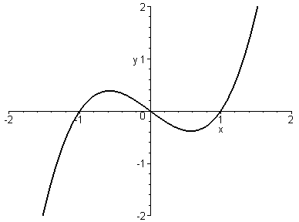
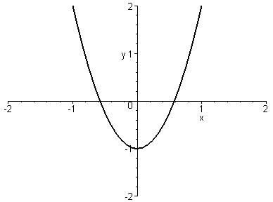
f
f’

Slide 12
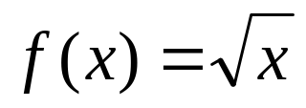
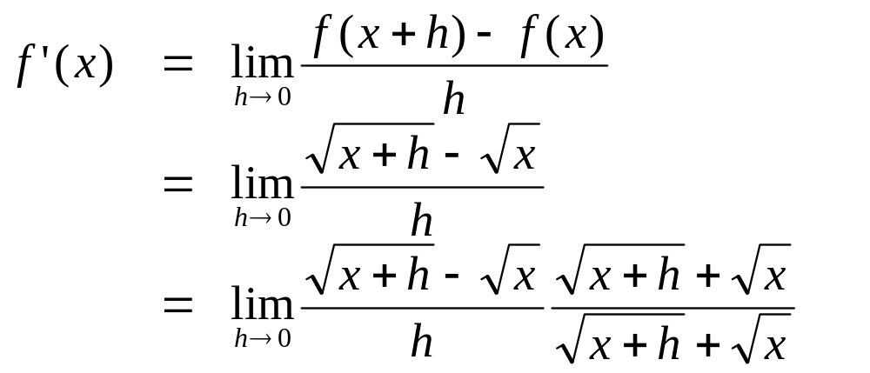
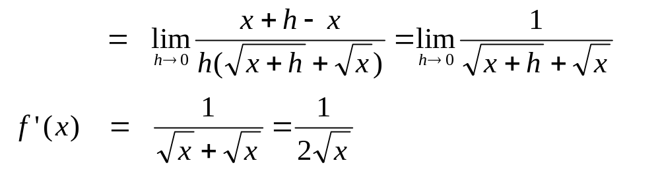
Example. Find f’ and its domain for
Solution.

Slide 13
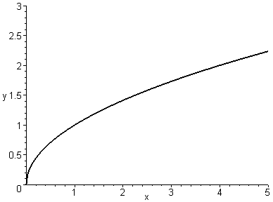
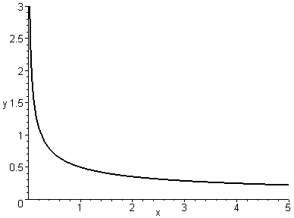
the domain of f’ is (0, ∞) while the domain of f is [0, ∞)

Slide 14
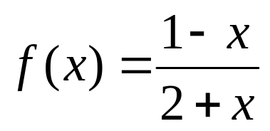
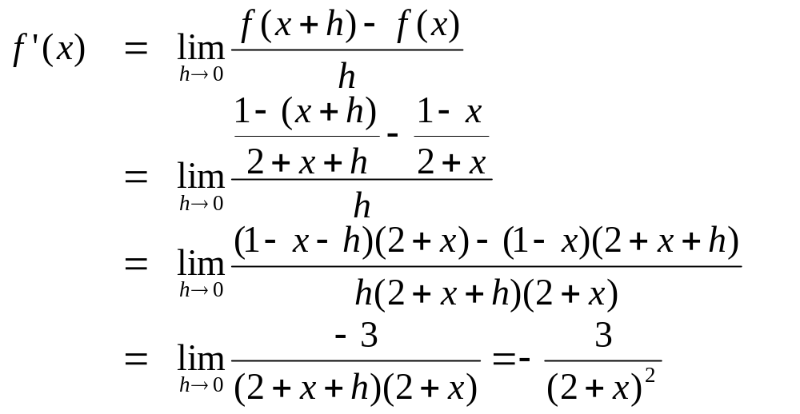
Example. find f’ if
Solution.

Slide 15
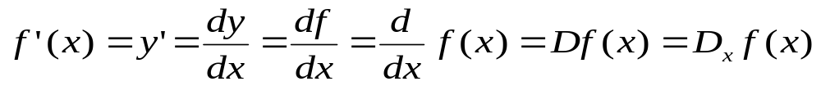
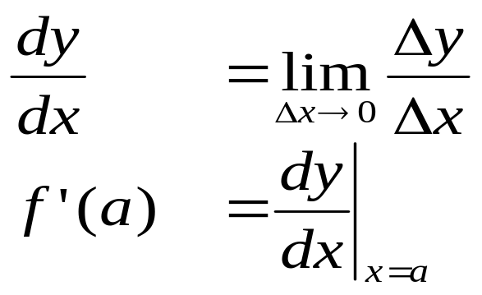
3.2.2 Differentiable Functions
Following are alternative notations for the derivative
The symbols D and d/dx are called differentiation operators.
In Leibniz notation:

Slide 16
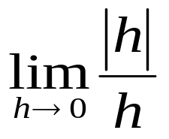
Definition 3. A function f is differentiable at a if f ’(a) exists. It is differentiable on an open interval I if it is differentiable at every point of I
Example. Where is the function f(x)=⎪x⎪ differentiable ?
Solution. We will prove later that the polynomial functions are differentiable on R.
f(x)=x if x > 0. So f is differentiable on (0, ∞)
f(x)=-x if x < 0. So f is differentiable on (-∞, 0)
Finally f ’(0) does not exist because does not exist

Slide 17
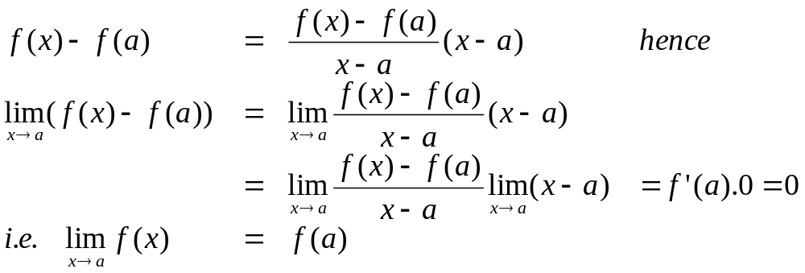
Theorem 4. If f is differentiable at a then f is continuous at a
Proof. We have for x ≠ a
Therefore f is continuous at a
Note that the converse of Theorem 4 is false: f (x)=⎪x⎪ is continuous but not differentiable at 0

Slide 18
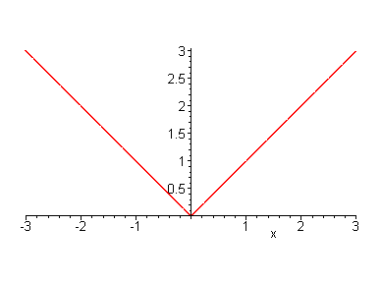
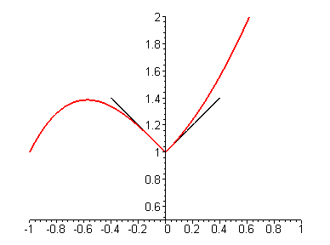
3.2.3 Non-differentiable Functions
The function f(x)=⎪x⎪ is not differentiable at 0: its graph change direction abruptly when x=0.
So are the graph of a function at the points where it has corners

Slide 19
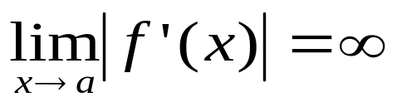
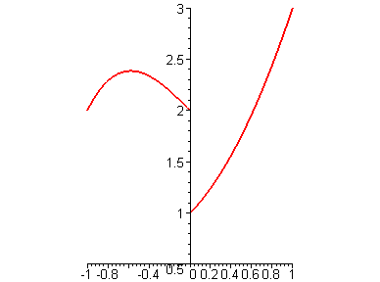
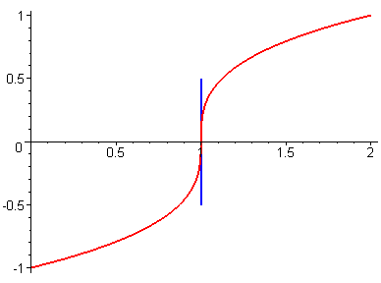
A function which is not continuous at a point a is not differentiable there
A function f(x) whose graph has a vertical tangent at the point (a, f(a)) is not differentiable at a. Indeed f is continuous at a and

Slide 20
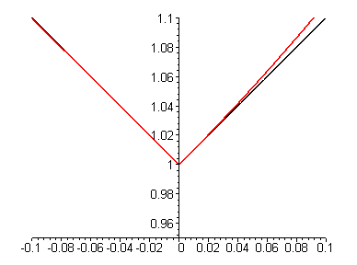
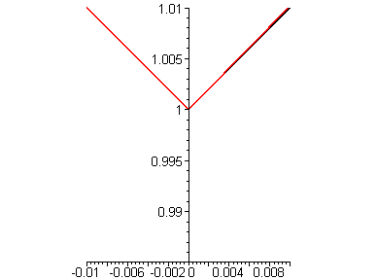
If f(x) is differentiable at a, then its graph has a tangent at P = (a, f(a)). When we zoom in toward P, the graph appears more like a line (its tangent).
However if the graph has a corner at a point P, then no matter how close we zoom in, the corner point cannot be eliminated.

Slide 21
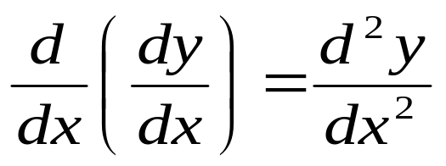
3.2.4 The Second Derivative
If f is differentiable, then its derivative f ‘, as a function, may have a derivative called the second derivative of f and denoted by (f ‘)’= f “.
In Leibniz notation, the second derivative of y = f (x) is written as

Slide 22
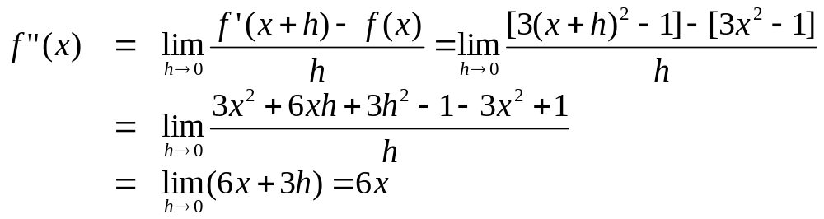
Example. If f(x) = x³ – x, find and interpret f “(x)
Solution. We have found that f ‘(x) = 3x² – 1, hence
f “(x) = 6x is the rate of change of the slope of the curve y = f(x)

Slide 23
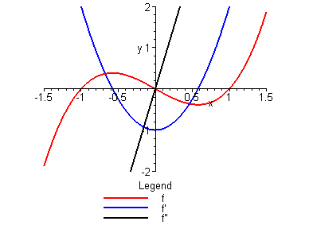
We sketch the curves y = f(x), y=f’(x), y=f”(x) in the same graph
when x increases from -∞ to 0, the slope decreases in a slower and slower rate.
when x increases from 0 to ∞, the slope increases in a more and more rapid rate

Slide 24
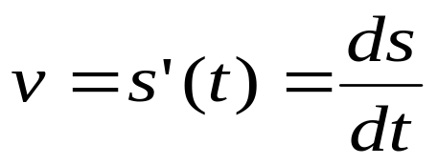
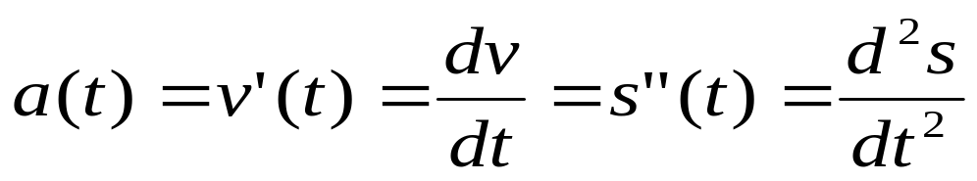
If the position of a particle is given by s=f(t), then the velocity is given by
The instantaneous rate of change of velocity with respect to time is called the acceleration of the particle

Slide 25
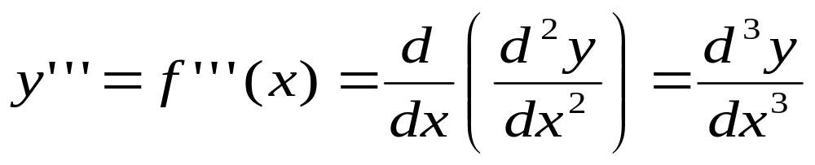
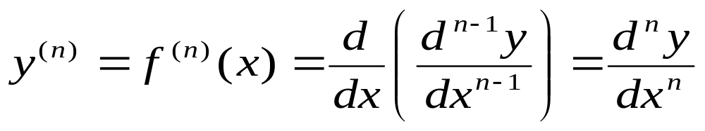
The third derivative of a function f is the derivative of the second derivative and denoted by (f “)’= f ‘’’.
In Leibniz notation, the third derivative of y = f (x) is written as
The n^{th} derivative of f is the derivative of the (n-1)^{th} derivative and denoted by (f ^{(n-1)})’= f ^{(n)}.

Slide 26
Example. If f(x) = x³ – x, find f ‘’’(x) and f ⁽⁴⁾(x)
Solution. The graph of f “(x) = 6x is a straight line with slope 6, so
f ‘’’(x) = 6.
The graph of the later is a horizontal line with slope 0. Therefore
f ⁽⁴⁾(x) = 0

Slide 27
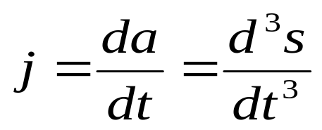
For the position equation s=f(t), the rate of change of the acceleration is called the jerk and given by

